Slide 1
SINGIZA GIHOZO MACRINE 27677 PL PHASEII WORK 25th April 2025

Slide 2

Problem Definition:
A pharmaceutical company conducts numerous clinical trials simultaneously, each involving various aspects like drugs being tested, participating patients, medical investigators at different sites, collected data points, and regulatory compliance requirements. Currently, they manage this information using a combination of spreadsheets, email communication, and disparate, non-integrated systems. This leads to data silos, inefficiencies in tracking progress, difficulties in ensuring data integrity and compliance, and challenges in generating comprehensive reports for decision-making and regulatory submissions.

Slide 3

Context:
The pharmaceutical industry is heavily regulated, requiring meticulous record-keeping and adherence to strict protocols (e.g., Good Clinical Practice - GCP). Clinical trials are complex, multi-stage processes that generate vast amounts of data. Efficiently managing this data is crucial for the timely and accurate development of new drugs. The lack of an integrated system hinders collaboration between different departments (research, medical affairs, regulatory affairs), slows down the trial process, and increases the risk of errors and compliance issues.

Slide 4
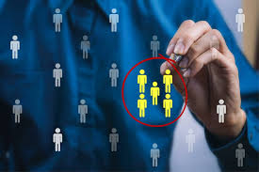
Target Users:
Clinical Trial Managers: Need to oversee the progress of multiple trials, track milestones, manage budgets, and identify potential risks.
Medical Investigators: Require a system to enroll patients, record observations, submit data, and communicate with the sponsor company.
Data Managers: Responsible for data entry, validation, cleaning, and ensuring data integrity.
Regulatory Affairs Personnel: Need to access and compile data for regulatory submissions (e.g., to the FDA, EMA).
Pharmacists: May need to manage drug supplies and dispensing for the trials.
System Administrators: Responsible for maintaining the database and application.

Slide 5

Project Goals:
The primary goals of implementing a PL/SQL-based Oracle database solution are to:
Centralize Data Management: Create a single, integrated repository for all clinical trial-related data, eliminating data silos and ensuring data consistency.
Improve Efficiency: Streamline workflows for patient enrollment, data collection, monitoring, and reporting.
Enhance Data Integrity and Quality: Implement data validation rules and audit trails to ensure accuracy and reliability of the collected data.
Facilitate Regulatory Compliance: Provide the necessary data and reporting capabilities to meet regulatory requirements and simplify the submission process.
Improve Collaboration: Enable seamless information sharing and communication between different stakeholders involved in the trials.
Provide Robust Reporting and Analytics: Generate comprehensive reports on trial progress, patient outcomes, and potential safety issues.

Slide 6
BPMN Diagrams:
Business Process Diagrams: To model the key business processes involved in conducting a clinical trial, such as:
Trial Setup: Defining the protocol, selecting sites and investigators, obtaining regulatory approvals.
Patient Recruitment and Enrollment: Screening, consenting, and enrolling eligible patients.
Data Collection: Recording patient visits, observations, and measurements.
Adverse Event Management: Reporting, investigating, and tracking adverse events.
Data Analysis and Reporting: Cleaning, analyzing, and generating reports on the trial data.
Regulatory Submission: Preparing and submitting trial data to regulatory authorities.
Each BPMN diagram would clearly show the sequence of activities, decision points, roles involved, and data flow within the process.

Slide 7
Patient Note: Interaction and Service Plan (Drug Addiction)
Date & Time: [Current Date and Time, e.g., 2025-05-25, 09:00 AM] Patient ID: [Unique Patient Identifier] Patient Name: [Patient Initials or First Name Only (e.g., J.D. or John D.) - Full name depends on specific institutional policy for documentation privacy] Service Provider: [Your Name/Role, e.g., Sarah L., Social Worker]
Subjective (S):
Patient's chief complaint/reason for seeking service: [e.g., "Patient self-referred for issues related to opioid use disorder."]
Patient's self-reported current drug use: [e.g., "Reports daily use of fentanyl, approximately 3-4 times per day, via inhalation. Last use reported 8 hours prior to session."]
Patient's perceived impact of addiction: [e.g., "Expresses frustration with inability to maintain employment and strained family relationships due to drug use."]
Patient's goals for treatment: [e.g., "States desire to stop using fentanyl and regain control over life."]
Relevant history (brief): [e.g., "History of polysubstance use since age 18. Previous treatment attempts, including one inpatient stay 6 months ago, which was not completed."]

Slide 8
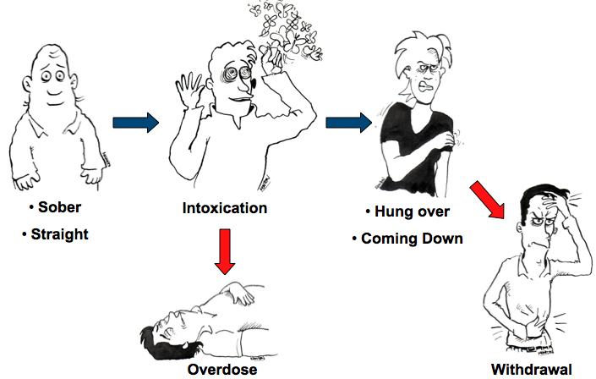
Objective (O):
Appearance: [e.g., "Appears disheveled but cooperative. Alert and oriented x 3."]
Affect/Mood: [e.g., "Anxious but hopeful. Speech clear and coherent."]
Physical observations (if relevant and within scope): [e.g., "Pupils slightly constricted. No overt signs of acute intoxication or withdrawal observed during session."]
Diagnostic/Screening tool results (if applicable): [e.g., "Scores 25 on AUDIT, indicating high risk for alcohol use disorder (if screened)."]
Verification of self-report (if possible/relevant): [e.g., "Reports consistent with previous intake documentation."]

Slide 9
Summary of clinical presentation: [e.g., "Patient presents with active opioid use disorder, currently experiencing functional impairment across multiple life domains."]
Risk assessment: [e.g., "High risk for relapse due to daily use pattern and previous incomplete treatment. No immediate suicidal ideation or homicidal ideation reported."]
Strengths identified: [e.g., "Patient maintains housing and expresses strong desire to reconnect with family."]
Patient's motivation for change: [e.g., "Patient demonstrates high motivation for change, as evidenced by self-referral and clear stated goals."]
Barriers identified: [e.g., "Lack of stable income, limited social support for recovery."]

Slide 10
Logical Flow and Dependencies:
The implementation of the PL/SQL solution would involve the following logical flow and dependencies:
Database Schema Design: Based on the UML Class Diagram/ERD, design the Oracle database schema with appropriate tables, columns, data types, primary keys, and foreign key constraints to enforce relationships and data integrity.
PL/SQL Package Development: Develop PL/SQL packages to encapsulate business logic and data access operations. These packages would include:
Procedures for data manipulation (insert, update, delete) for each entity.
Functions for data validation and complex calculations.
Triggers to enforce business rules
3.User Interface (UI) Development (Dependency: Database and PL/SQL): Develop a user-friendly front-end application (e.g., using Oracle APEX, Java, or other web technologies) that interacts with the PL/SQL packages to allow users to perform their tasks. The UI would be dependent on the underlying database structure and the PL/SQL procedures and functions.
Security and Access Control (Dependency: Database Design):use of robust security within the Oracle database to control user access to specific data and functionalities based on their roles.

Slide 11
2\.Testing and Validation (Dependency: All Previous Steps): Thoroughly test all components of the system, including the database schema, PL/SQL code, and user interface, to ensure they function correctly and meet the project requirements.
END

